Slide 1

Data Science Final Project
Arkael Kernizan
CMP – 262

Slide 2
Streaming Data
Potential Clients:
Streaming service providers
Creators of media
Marketing teams
Users

Slide 3
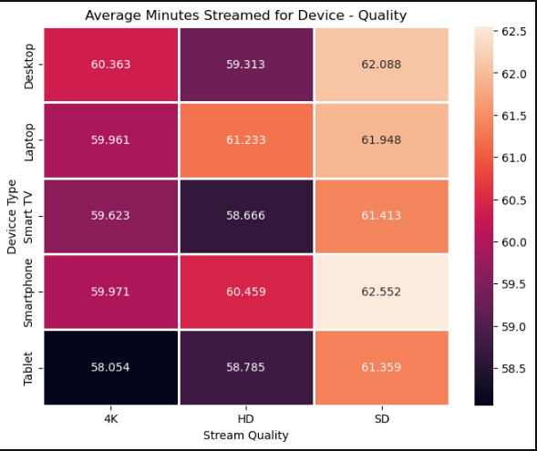
Based on device and playback quality, what is the average time spent streaming?
Highest:
Smartphone – SD
Desktop – SD
Lowest:
Tablet – 4K
Smart TV - HD

Slide 4
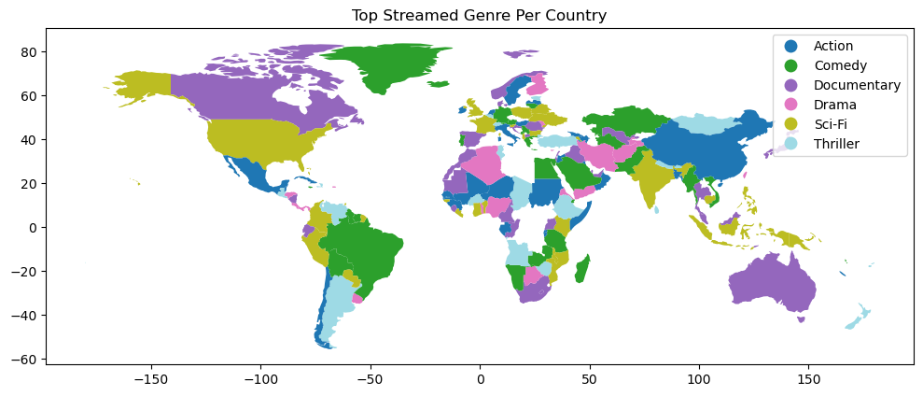
What are the top genres per country?

Slide 5
Future work?
How do genre change for countries over time?

